Slide 1
Overview of Current Work
Geffen Cooper

Slide 2
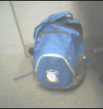
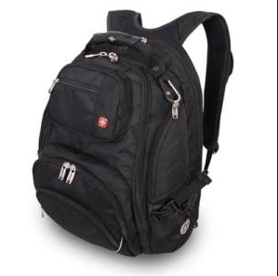
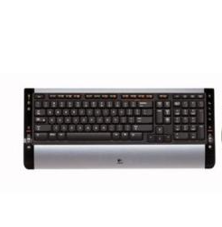
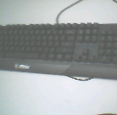
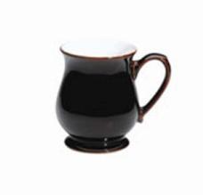
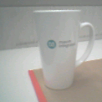
Quick Review of Domain Adaptation
Train on Source Domain (online dataset)
Test on Target Domain (MAX78000 Camera)
CNN
CNN
“Backpack”
“Mug”
CNN
CNN
“Keyboard”
“Backpack”
CNN
CNN
“Mug”
“Keyboard”
Notes:
Typically, we train models on pre-collected datasets from online since data collection/annotation is expensive
The implicit assumption is that the data that will be seen during inference time comes from the same distribution
So, we may see great results on our test set (e.g. > 95% accuracy)
However, in reality the data we do inference on does not come from the same distribution as the training data which is typically clean/high quality/high resolution/fixed
As a result, we see poor performance when we test our model on the MAX78000 since the data while semantically the same has some distribution shift
For example, image brightness and contrast, slight distortion, noisy background

Slide 3
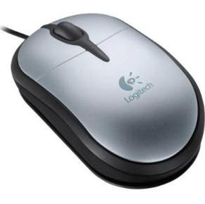
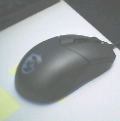
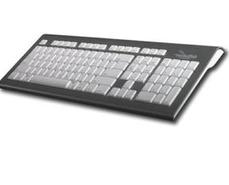
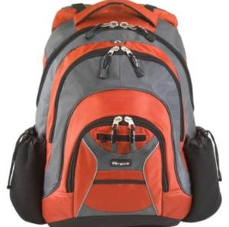
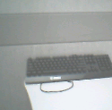
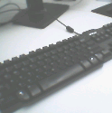
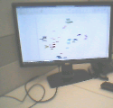
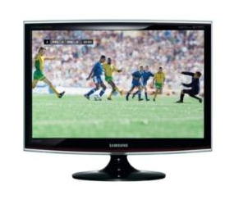
Few-Shot Adversarial Domain Adaptation
G1: same class, same domain
G2: same class, different domain
G3: different class, same domain
G4: different class, different domain
Ex: Generate 48 samples given 15 images.
G2 has 12 possible pairs → equal class split = 48 pairs
Source = {C1,C1,C1,C1 C2,C2,C2,C2 C3,C3,C3,C3} Target = {C1, C2, C3}
Notes:
Ideally, we would just collect a new dataset in the target domain but as mentioned, data collection/labeling is expensive
Also, in this case it is not super easy to collect images with a maxim board
We want our model to learn domain-invariant features with the constraint of having few examples from the target domain
This means images from the same class should be clustered closer than images from the same domain
Rather than treating individual images as sample, we can generate more samples by creating image pairs which provide information about the domain and the class label

Slide 4
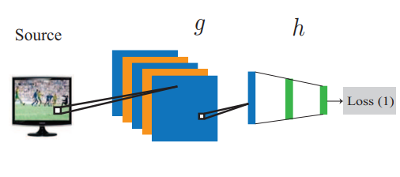
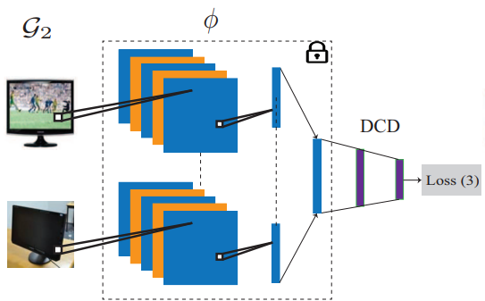
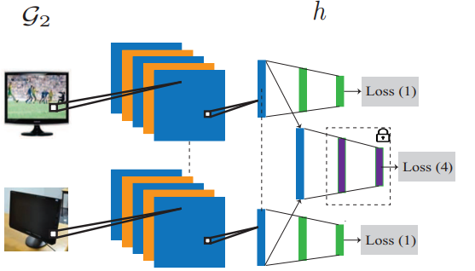
Few-Shot Adversarial Domain Adaptation
Step 1: Train on Source Data
Step 2: Train the Domain-Class Discriminator
Step 3: Train the Encoder to Trick the Discriminator
Notes:
We start by training a normal CNN on the source dataset and get good classification accuracy
Then we add a few linear layers called the domain-class discriminator which will distinguish the image pairs (note that the CNN is frozen)
We pass in each image through the CNN to generate embeddings
We concatenate these embeddings and pass-through the domain-class discriminator until it gets good classification accuracy
Now we freeze the discriminator and train the encoder but with a new loss
We pass in Class 2 and 4 with labels 1 and 3 respectively
If we minimize this loss as well as the original class loss, then the CNN has failed to distinguish domains while having good classification accuracy

Slide 5
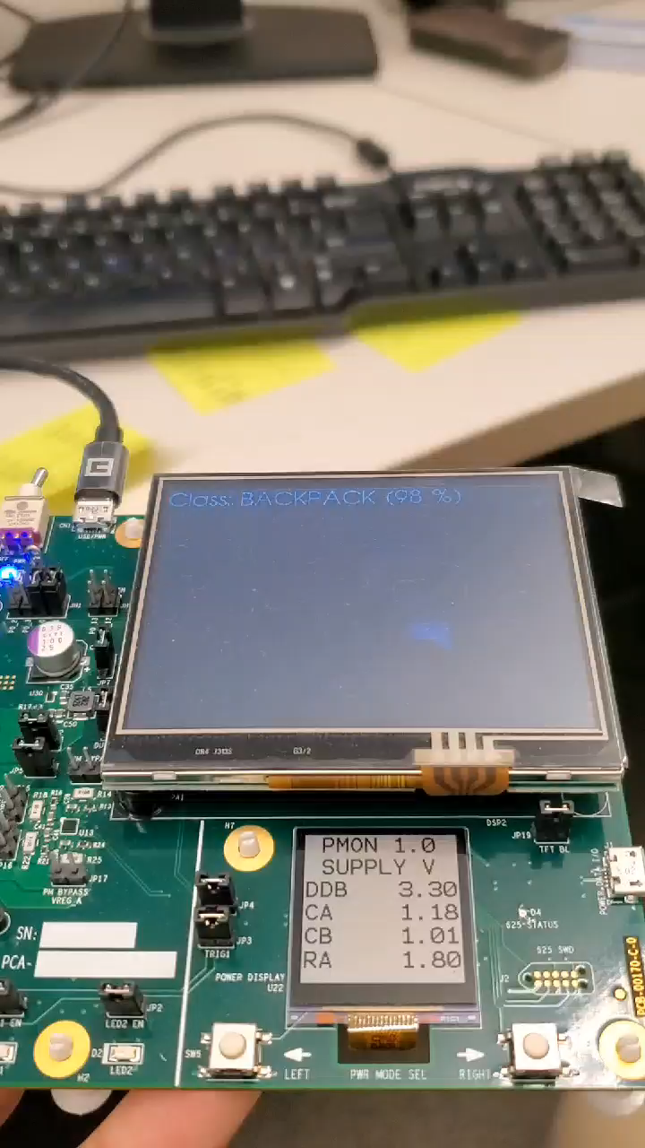
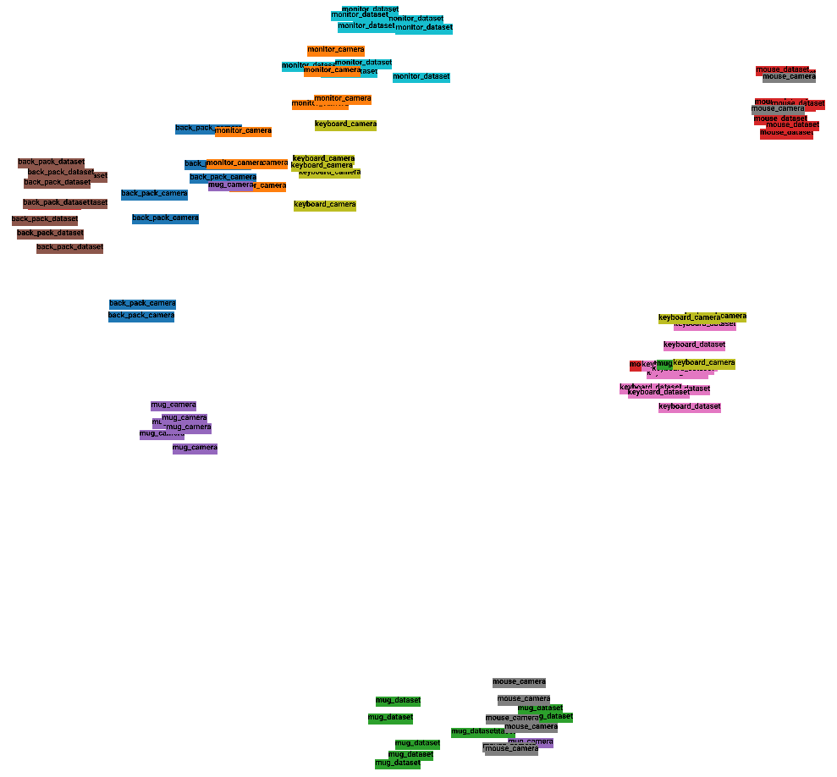
Without Domain Adaptation (only source data)
Mouse
Monitor
Backpack
Keyboard
Keyboard
Mug
T-SNE plot of 128-dimensional embeddings from encoder part of the model
Mug
Mouse
Notes:
In this t-SNE plot we see that while the images from the target domain (camera) still cluster relatively well, they become offset from the source domain images. This causes the model to misclassify images as seen in the video.

Slide 6
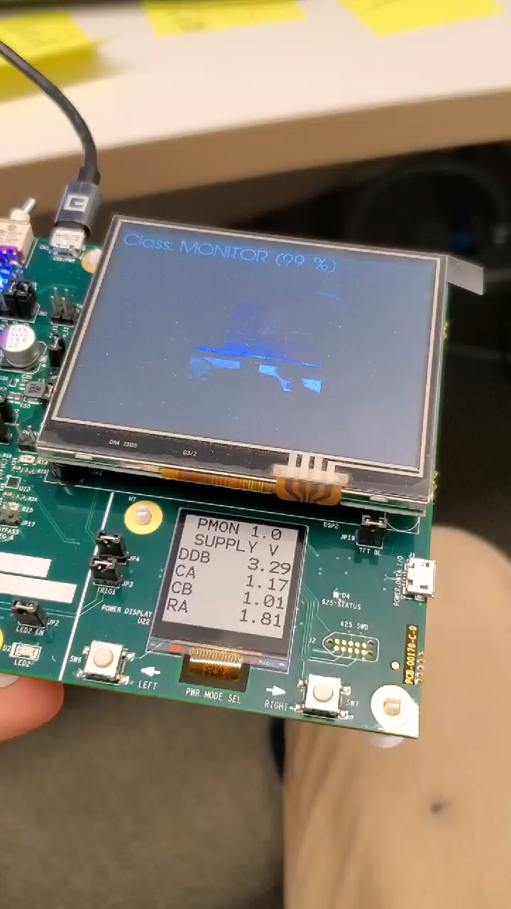
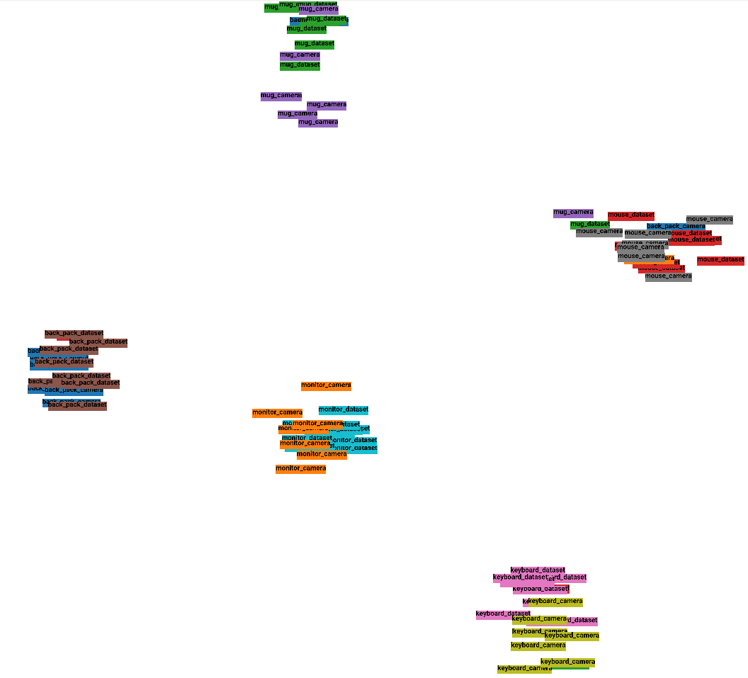
With Domain Adaptation (4 additional images per class from camera)
Mouse
Mug
Backpack
Monitor
T-SNE plot of 128-dimensional embeddings from encoder part of the model
Keyboard
Notes:
After employing domain adaptation (with only 4 images from the target domain per class), we see that the images cluster into 5 distinguishable classes where the source and target domain images overlap. This shows that the encoder has learned to generate domain-invariant features while maintaining good features for classification. This results in much better classification as seen in the video. We can expect the results to improve more as we add more images from the target domain.

Slide 7
Current Tasks
Rigorous testing to validate method
Collect a diverse unseen test set as a baseline
Compare results across k = 4,8,16-shot training
Compare to naïve mix of source and target
Test method in different lighting (new domain) with k = 2-shot-training
Improve/Expand model
More pretraining
Add more source images
Add background category
Add more classes

